Slide 1

Mathematics in the EYFS
September 2021

Slide 2
Six Areas of Mathematics
Cardinality and Counting
Comparison
Composition
Pattern
Shape and Space
Measures
In Reception, children need to develop a strong sense of numbers to 10. This will provide a solid foundation as they move into Key Stage 1.

Slide 3
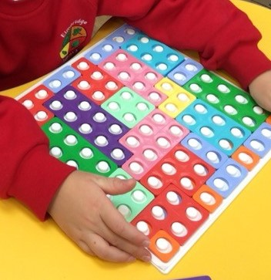
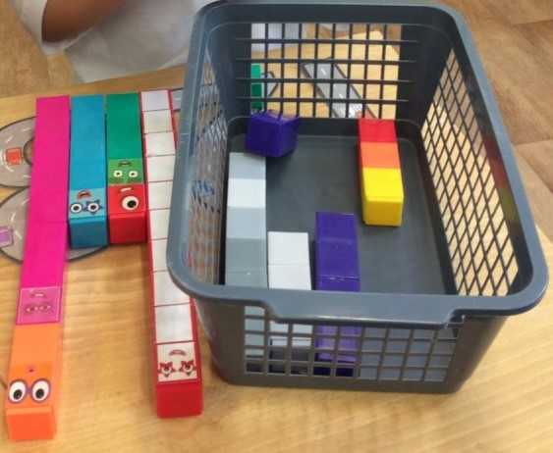
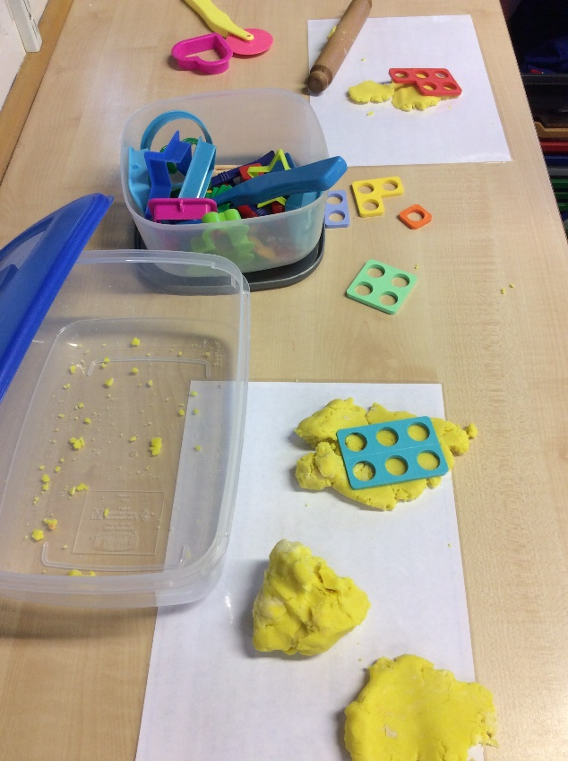
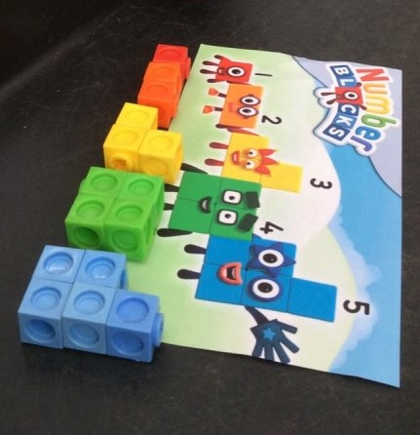
Familiarisation

Slide 4
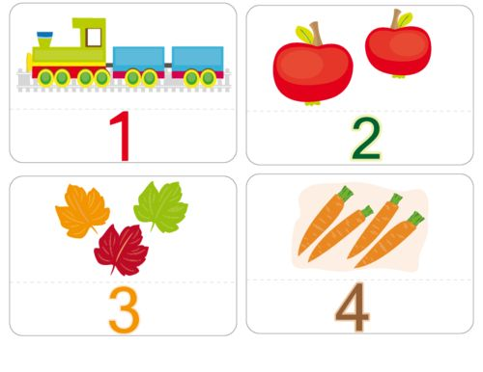
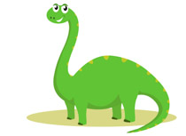
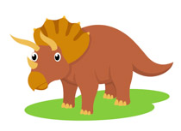
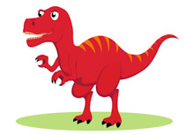
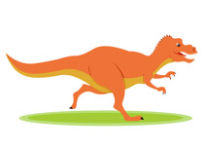
Cardinality and Counting
Count reliably
  Recite numbers in order – stable-order principle
  Match an object to a number - one to one correspondence
  Understand the final number represents the number of items – cardinal principle
  Objects can be counted in any order, as long as each item is counted only once – order-irrelevance principle
  Understand not only objects can be counted (sounds) – abstraction principle
  Count a given set of objects and count out from a larger set

Slide 5
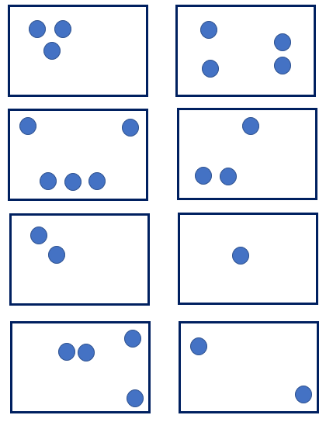
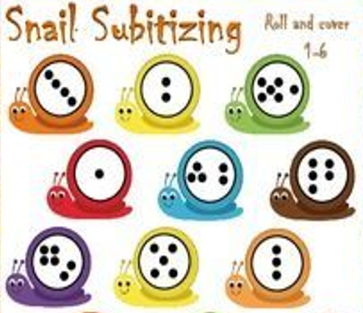
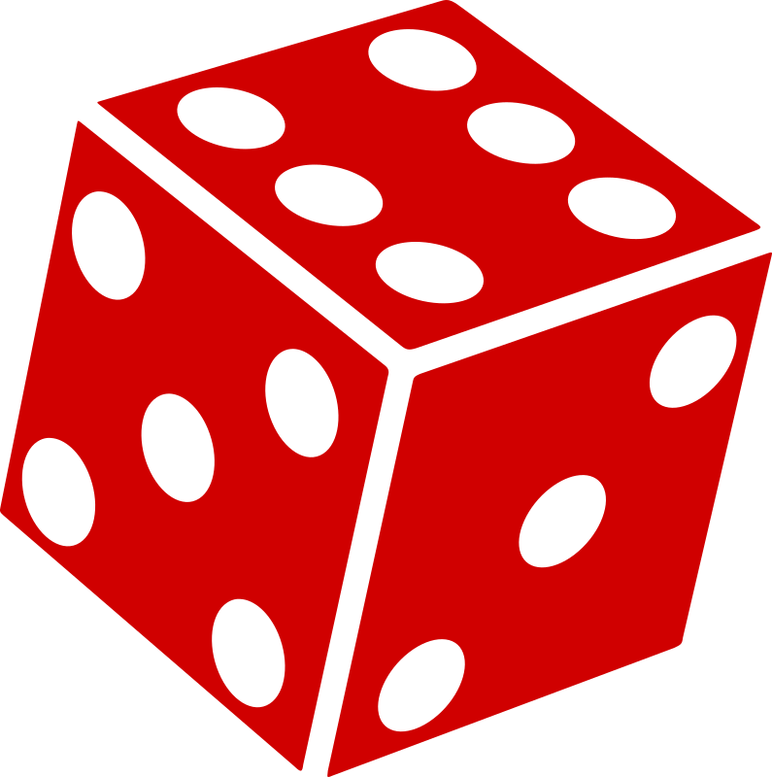


Subitising
To instantly recognise a small number of objects without counting.

Slide 6
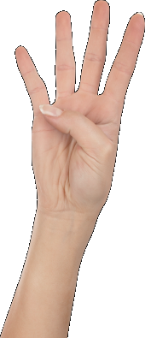
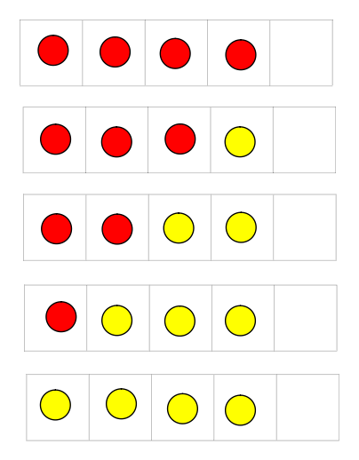
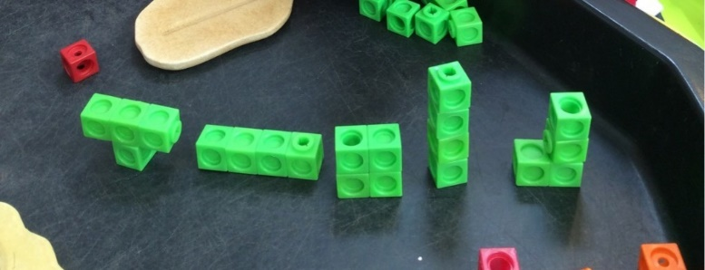
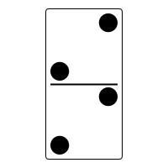


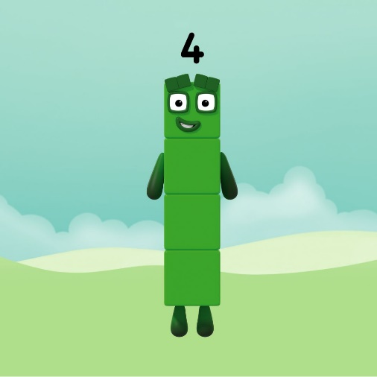
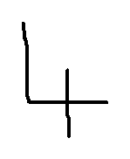


Representing numbers in different ways help children to understand the link between numbers and quantity.

Slide 7
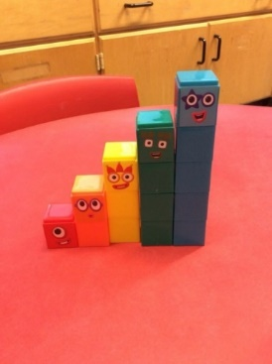
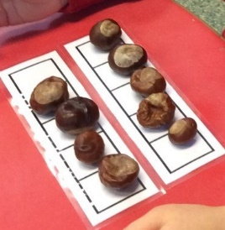
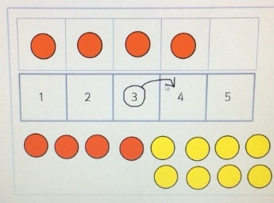
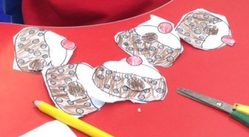
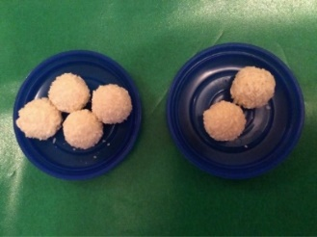
Comparison
To know which numbers are worth more or less than each other. To recognise if a number is a lot bigger or a bit bigger than a number.
Compare objects by matching them to recognise which group has more, fewer or the same number of objects.
To recognise one more/one less relationship between sequential numbers.
Sing number rhymes to support one more/less.
Which plate of chocolates would you like to take? Why?

Slide 8


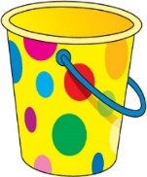
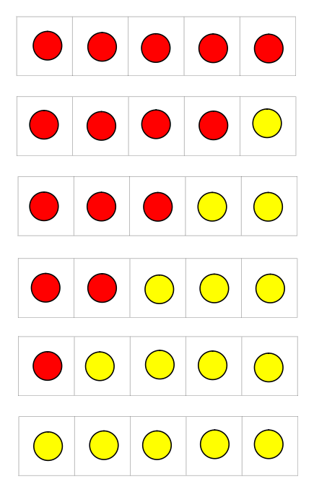

Composition
To know numbers are made up of two or more other smaller numbers. Combine groups to make a total. 4 spots altogether. I can see…
To partition a number into different numbers. Separate a number of objects into 2 or more groups.
To know number bonds.
Understanding composition through games, such as playing skittles and throwing bean bags into a hoop.

Slide 9
Questioning and Reasoning
How do you know?
Why?
What if…?
What is the same/different?
Convince me.
Show/find me another way. And another…
I know…because…
Children apply their understanding to reason and solve problems.
Children to explain their mathematical thinking.

Slide 10
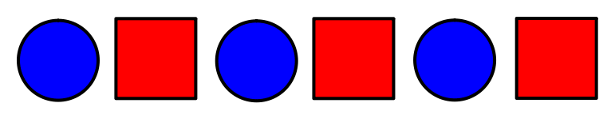
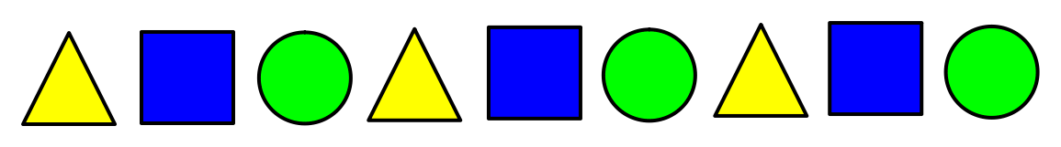
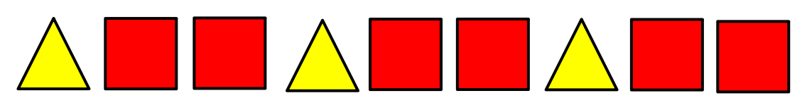
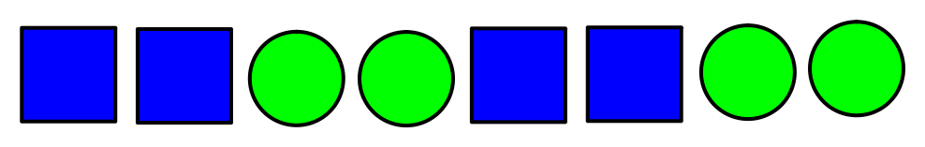
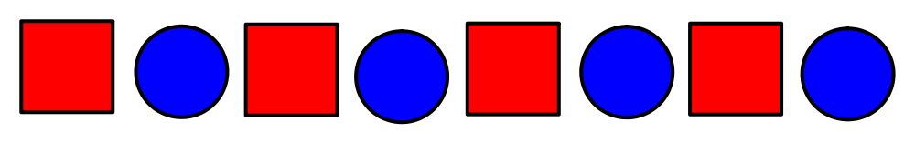
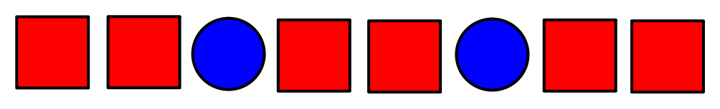
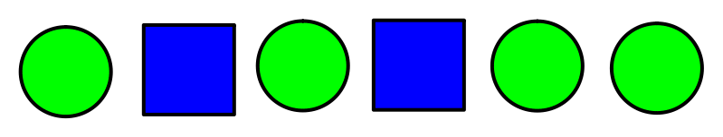
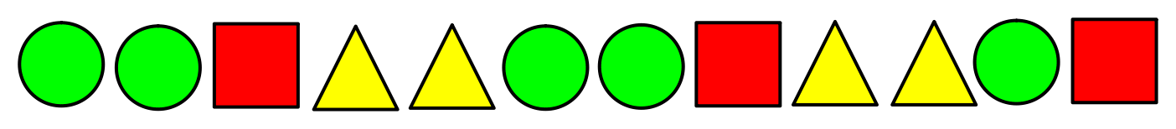
Pattern
Simple patterns
Complex patterns
Recognising, copying and extending a pattern
Compare patterns
Spot and correct errors

Slide 11
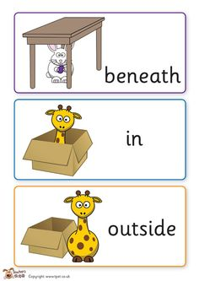

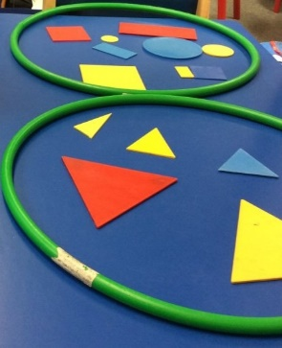
Shape and Space
Shapes and their properties
  2D and 3D shapes
Spatial language
  Position and direction

Slide 12
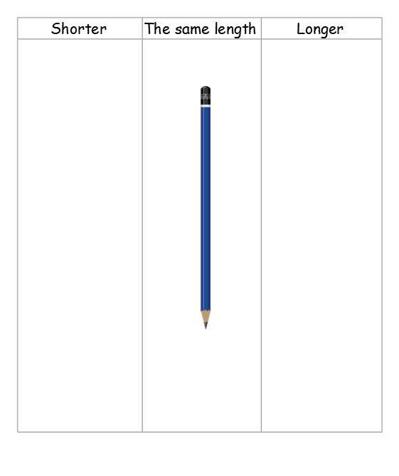
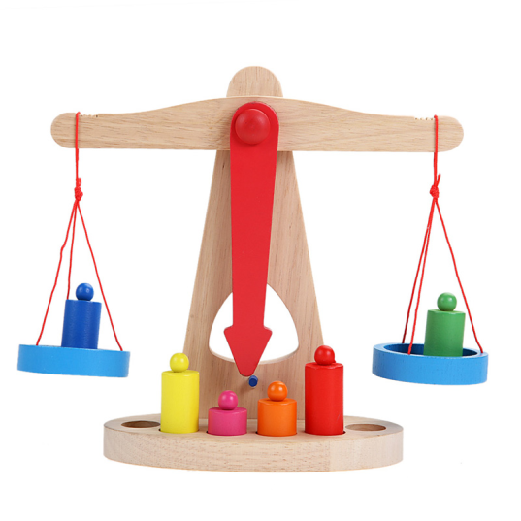
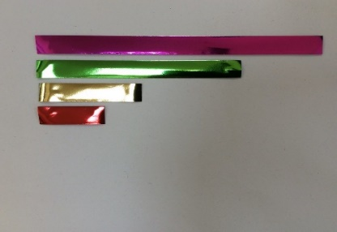
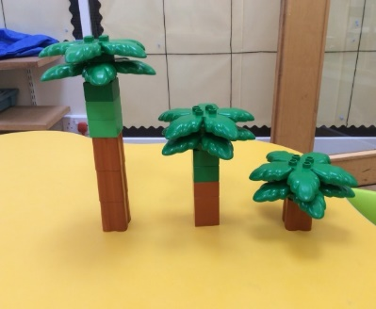
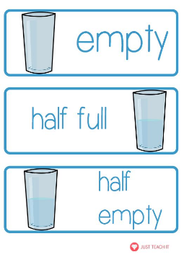

Measures
Compare sizes, lengths, weights and capacities
Estimating and predicting
Time

