Slide 1
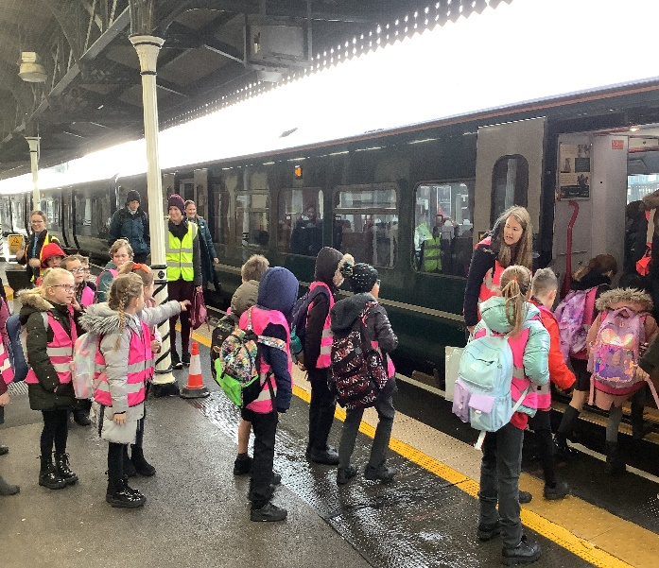
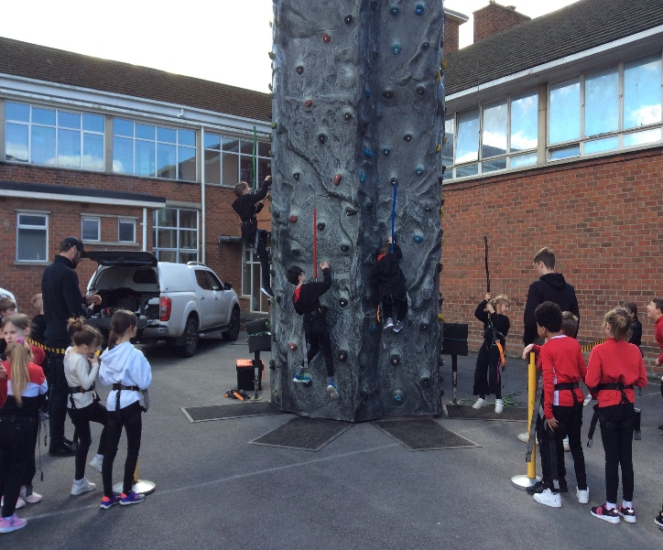
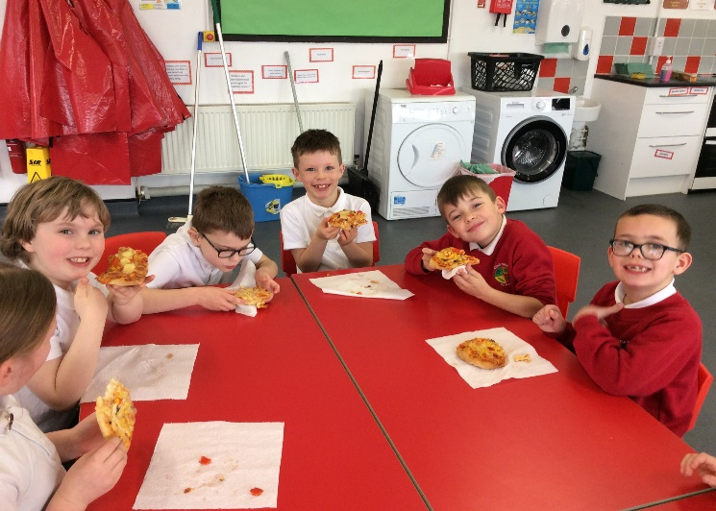

Welcome to
Elmbridge Primary School!

Slide 2

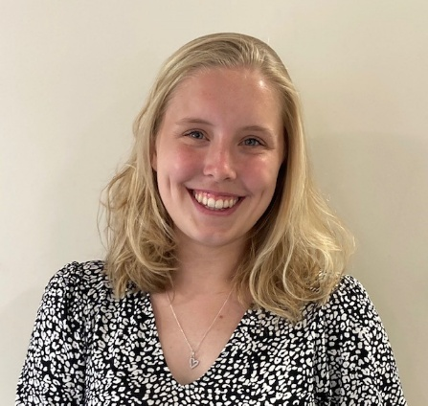
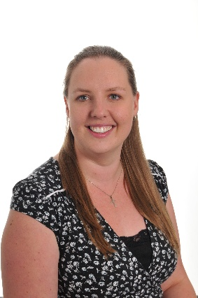
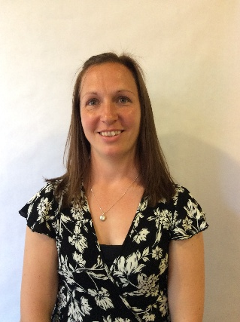
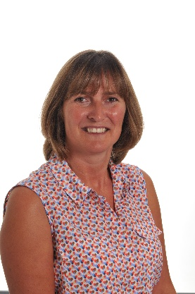
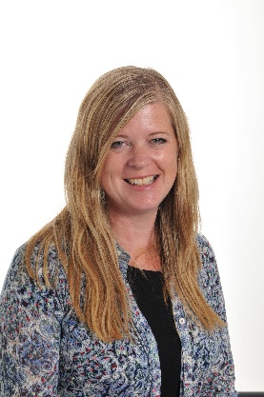
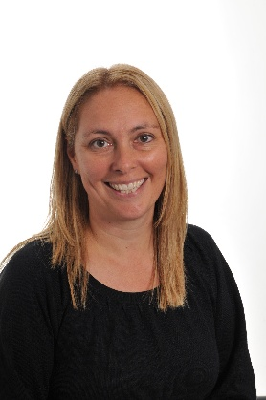
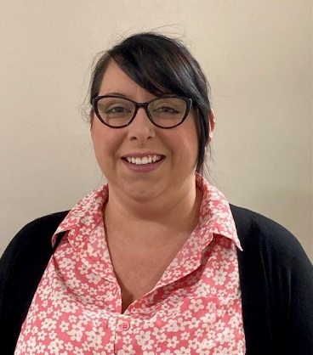
Meet the Staff
Phase Leader – Mrs V Toppin
Year Group Leader – Mr D Jones
Class 7 Class 8 Class 9
Mrs Barthorpe Mr Jones Miss Marsh and Mrs Toppin
Mrs Coughlan Mrs Hardman Mrs Holl Miss Taylor

Slide 3
Elmbridge Primary School’s Intent
Our pupils will be confident to embrace the next stage of their learning
Pupils will have enquiring minds, be independent and resilient
Pupils will value the importance of reading and be able to communicate ideas effectively
Staff and pupils will know how to look after their physical and mental health
Staff and pupils will show respect, tolerance and compassion for each other
The Elmbridge curriculum will evolve to reflect the knowledge and skills needed for life in the 21st Century
As a school, we work together to promote our school rules of being:
Ready | Respectful | Safe
Notes:
They would have had this in reception coming through the infants.

Slide 4

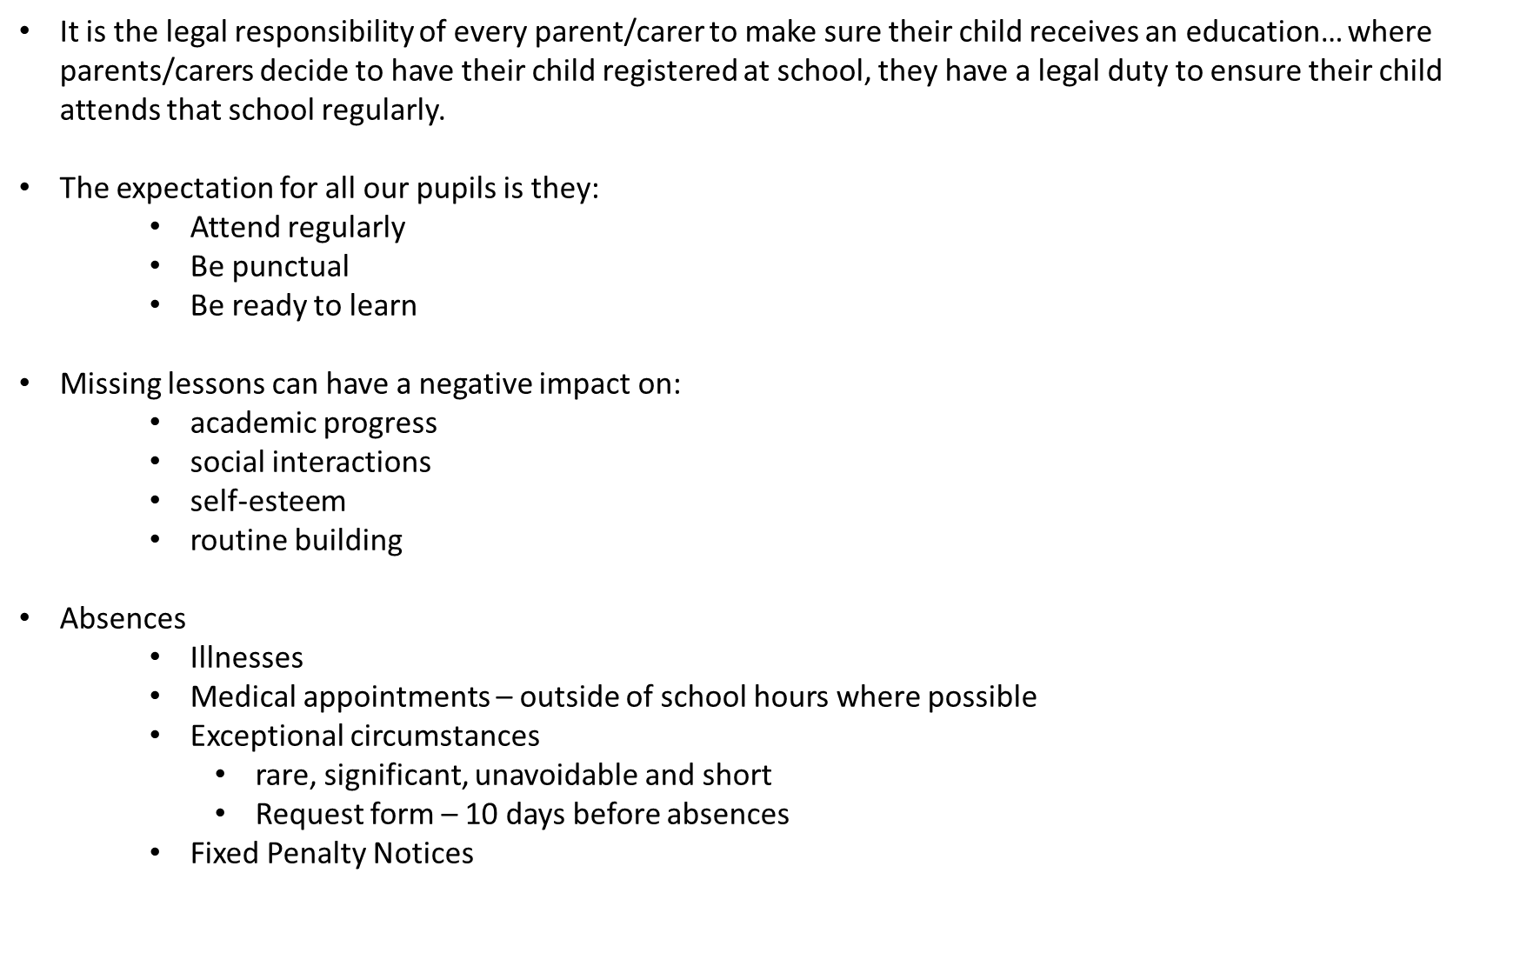

Slide 5
Preparation for entering KS2
Year 2 visit for lunch to become familiar with the dining room and lunchtime routine
Year 2 play on the Year 3 playground and field at lunchtime in Term 6
Visits throughout the year to the KS2 building to use the Shake and Bake Room and the Computer Suite
Year 3 Staff visit Year 2 children and talk to their teachers
Infant children to take part in whole school sports events and Green Day
Visited new classes on Thursday 2nd July 2026

Slide 6
Uniform
PE kit in school at all times - red t-shirt and black shorts with trainers (no jewellery to be worn)
School shoes not trainers (except playtimes)
No jewellery other than stud earrings and watches (no SMART watches).
Hair longer than shoulders needs to be tied back
All uniform MUST be clearly named

Slide 7
Food
Water bottles with sports tops in class
Fruit or vegetable snack – needs to be provided from home
School meals cooked on site - £2.95
(FSM need to apply as school gets funding)
Choice of menu
School meals to be paid for in advance via the internet

Slide 8
Changes that you will notice between Year 2 and Year 3
In Year 3 any photos of activities are put on the website in the gallery on the Year 3 page
Children will have spelling and maths homework along with their regular home reading
The children will start to learn French
The children will have 5 weeks of swimming lessons at Sir Thomas Rich’s pool
Every class will have 10 weeks of whole class instrument lessons from a peripatetic music teacher
Year 3 children are encouraged to become independent and take responsibility for their own property. Please help your child by making sure all of their things are labelled with their name and class
Notes:
Only TTRS for homework and Edshed
Summer Term for swimming
Monday afternoons – check when it starts

Slide 9
First Day – Wednesday 2nd September
Year 3 doors open at 8.40am
Children will go to the KS2 Hall – the hall doors will be open
Children line up in their classes in the hall
Lunches – no need to pay for hot dinners on the first day, you will be charged for them when ‘Parentpay’ is set up
School ends at 3.10pm. The children will exit the school through the doors next to the KS2 Hall. If your child is attending after school club we will escort them there
Notes:
We have a staggered start so that not all 180 children come in at the same time and feel overwhelmed from the start of the day.

Slide 10
Start of a normal school day
During the first day in Year 3, the children will practice coming into school through the entrance that they will normally use when they come into school
From Thursday 3rd September the children will enter school through the Year 3 back /rear cloakroom door, hang up their things on their coat peg and make their way to their classroom to start morning jobs
Y3 staff are on duty in the cloakroom every morning to help children come safely into school

Slide 11
Contact Us
Home/School Diary
Catch us before or after school
‘Tea with the Team’– TBA
Email
admin@elmbridgeprimary.co.uk
Tel: 01452 523632

Slide 12
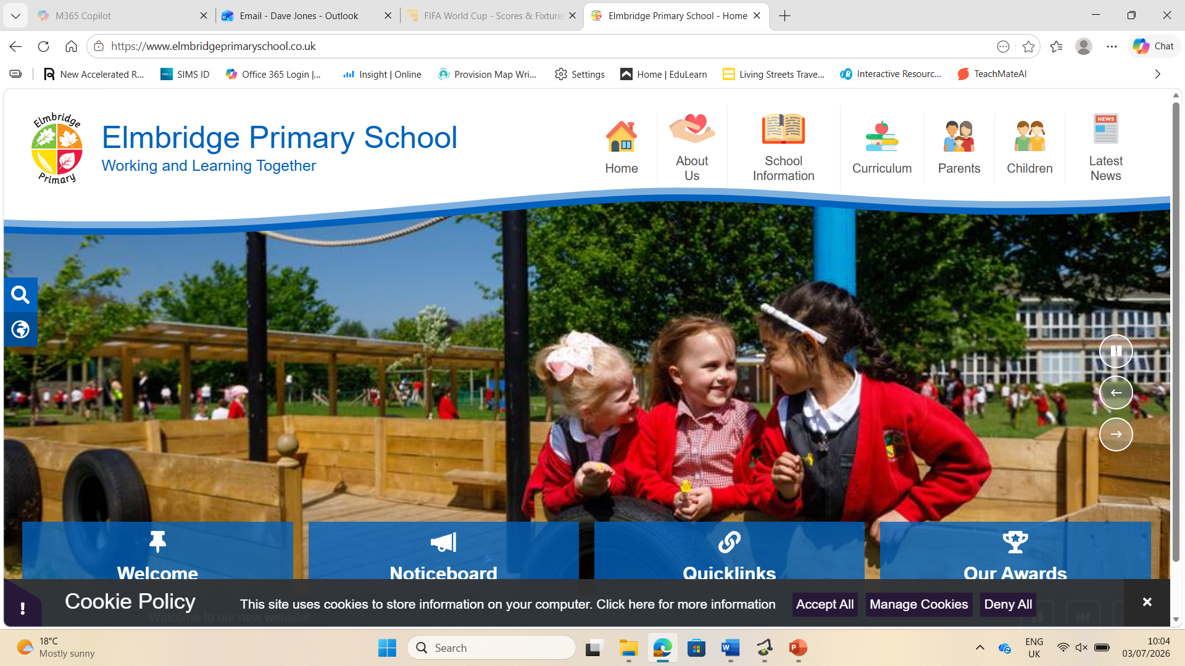
Website www.elmbridgeprimaryschool.co.uk

Slide 13
And finally…
Any questions?
Notes:
Any personal questions about your child, please could you speak/ask at the end.

